Slide 1
Http methods
Best Practices

Slide 2
Use HTTP Methods & API Routes
As a best practice, your API routes should always use nouns as resource identifiers. Speaking of the user’s resources, the routing can look like this:
POST /user or PUT /user:/id to create a new user,
GET /user to retrieve a list of users,
GET /user/:id to retrieve a user,
PATCH /user/:id to modify an existing user record,
DELETE /user/:id to remove a user.

Slide 3
Use HTTP Status Codes Correctly
1xx informational response – the request was received, continuing process
2xx successful – the request was successfully received, understood, and accepted
3xx redirection – further action needs to be taken in order to complete the request
4xx client error – the request contains bad syntax or cannot be fulfilled
5xx server error – the server failed to fulfil an apparently valid request

Slide 4
Request Method (HTTP)
→ GET()
→ POST()
→ PUT()
→ DELETE()
→ POST() request are done mostly on server side
→ Have

Slide 5
Simple GET() Request
var express = require('express');
app = express();
app.get('/', (req, res) => {
try {
res.send("This is simple get request");
}
catch (error) {
console.log("failed!", error);
}
})
app.listen(8000, () => {
console.log("server connection successful!");
});

Slide 6
GET() Request With URL Query
var express = require('express');
app = express();
app.get('/query', (req, res) => {
let firstName = req.query.firstName;
let lastName = req.query.lastName;
let age = req.query.age;
res.end(firstName + " " + lastName + " " + age);
});
app.listen(8000, () => {
console.log("server connection successful!");
});

Slide 7
GET() Request Header
var express = require('express');
app = express();
app.get('/header', (req, res) => {
let firstName = req.header('firstName');
let lastName = req.header('lastName');
let age = req.header('age');
let userAgent = req.header('User-Agent');
// The header values should be given in header before
// sending the get() request using postman
res.end(firstName + " " + lastName + " " + age + " " + userAgent);
});
app.listen(8000, () => {
console.log("server connection successful!");
});

Slide 8
Simple POST() Request
var express = require('express');
app = express();
app.post('/', (req, res) => {
try {
res.send("This is simple post request");
}
catch (error) {
console.log("failed!", error);
}
})
app.listen(8000, () => {
console.log("server connection successful!");
});

Slide 9
POST() Request With URL Query
var express = require('express');
app = express();
app.post('/query', (req, res) => {
let firstName = req.query.firstName;
let lastName = req.query.lastName;
let age = req.query.age;
res.end(firstName + " " + lastName + " " + age);
});
app.listen(8000, () => {
console.log("server connection successful!");
});

Slide 10
POST() Request Header
var express = require('express');
app = express();
app.post('/header', (req, res) => {
let firstName = req.header('firstName');
let lastName = req.header('lastName');
let age = req.header('age');
let userAgent = req.header('User-Agent');
// The header values should be given in header before
// sending the POST() request using postman
res.end(firstName + " " + lastName + " " + age + " " + userAgent);
});
app.listen(8000, () => {
console.log("server connection successful!");
});

Slide 11
POST() Request JSON in Body
var express = require('express');
var bodyParser = require('body-parser');
app = express();
app.use(bodyParser.json());
app.post('/json', (req, res) => {
try {
let jsonData = req.body;
// let jsonString = JSON.stringify(jsonData);
let jsonName = jsonData.name;
let jsonCity = jsonData['city'];
// res.send(jsonString);
res.send(jsonName + " " + jsonCity);
}
catch (error) {
console.log("failed!", error);
}
});
app.listen(8000, () => {
console.log("server connection successful!");
});
→ We have to send json data in body before sending post request

Slide 12
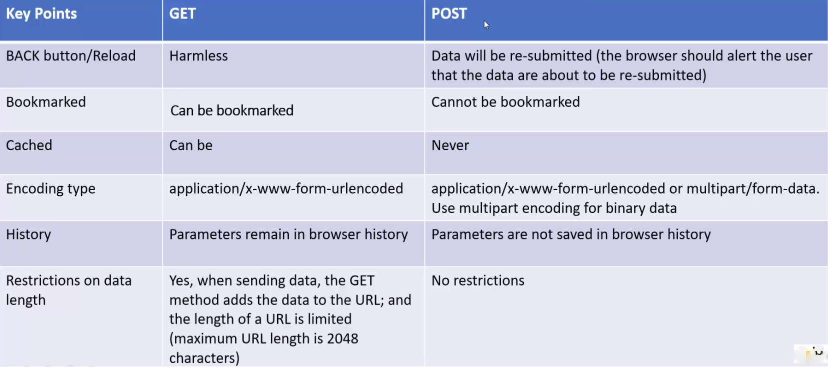
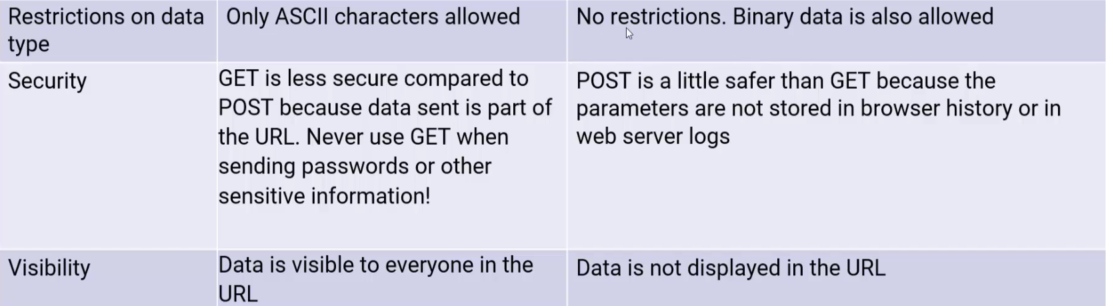
GET vs POST

Slide 13
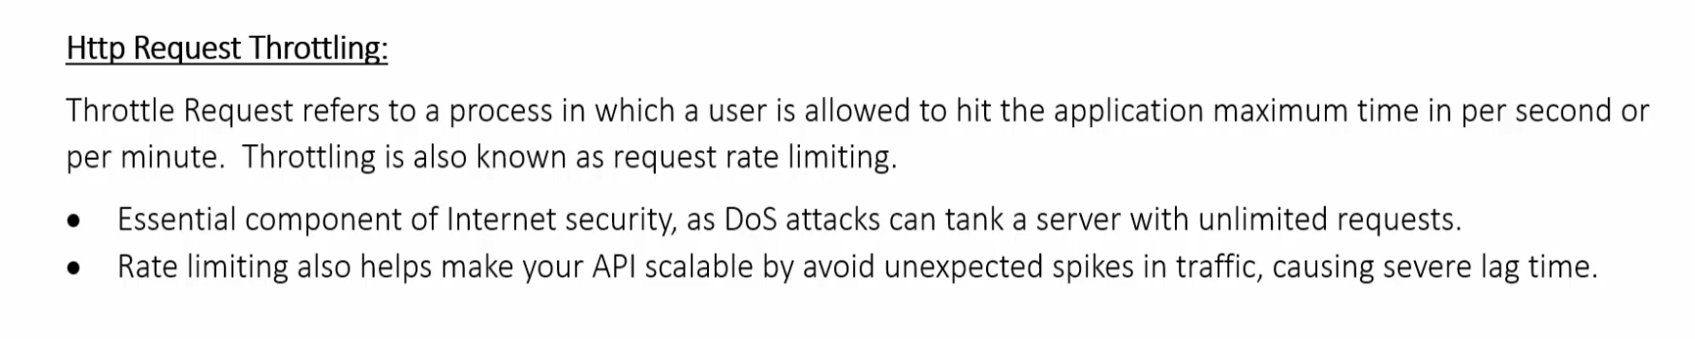
HTTP Throttling
Limiting the number of requests from a certain IP address for preventing a DOS attack
Express package to implement HTTP throttling

Slide 14
Use HTTP headers to Send Metadata
To attach metadata about the payload you are about to send, use HTTP headers. Headers like this can be information on:
pagination,
rate limiting,
or authentication.

Slide 15
Black-Box Test your Node.js REST APIs

Slide 16
Do JWT-Based, Stateless Authentication

Slide 17
Use Conditional Requests

Slide 18
Create a Proper API Documentation

